Slide 1



NERVCON
BCI Gaming made easy
Nervcon Team 63
Michele Romani, Martin Walchshofer, Leo Schreiner, Enes Arslan, Bernard Wong

Slide 2
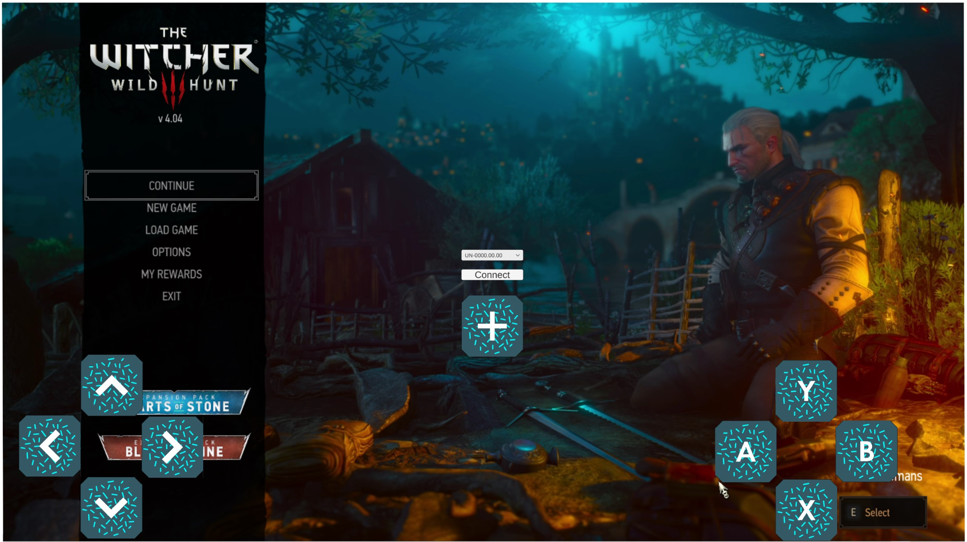
The Problem: BCI games are mostly built from the BCI perspective and just for one use-case
We want to integrate BCI into existing games

Slide 3
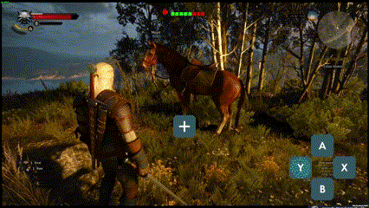
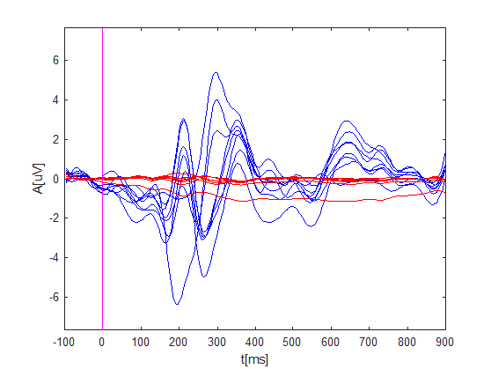
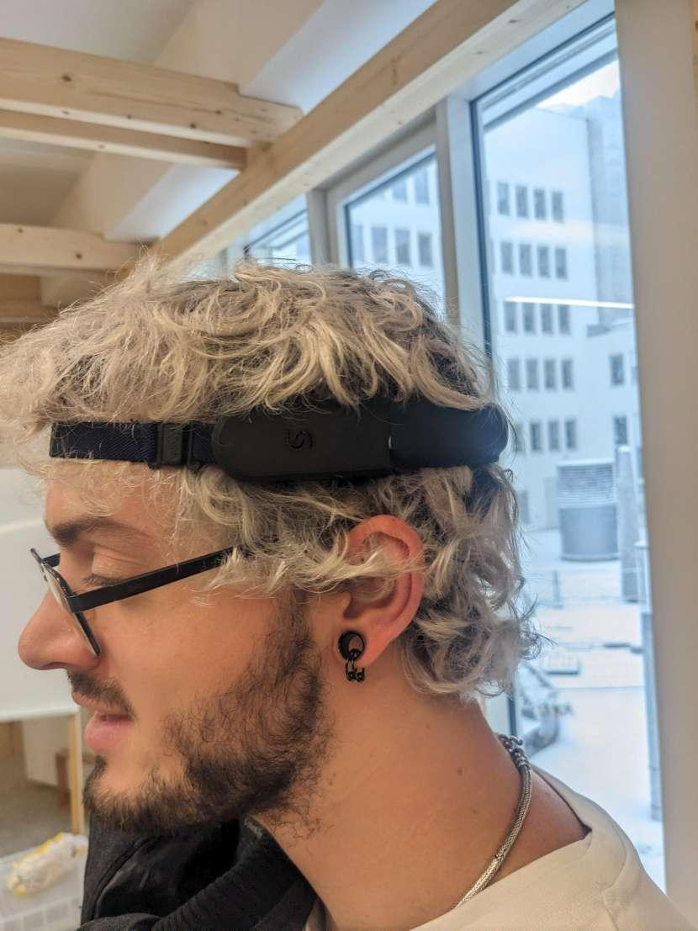
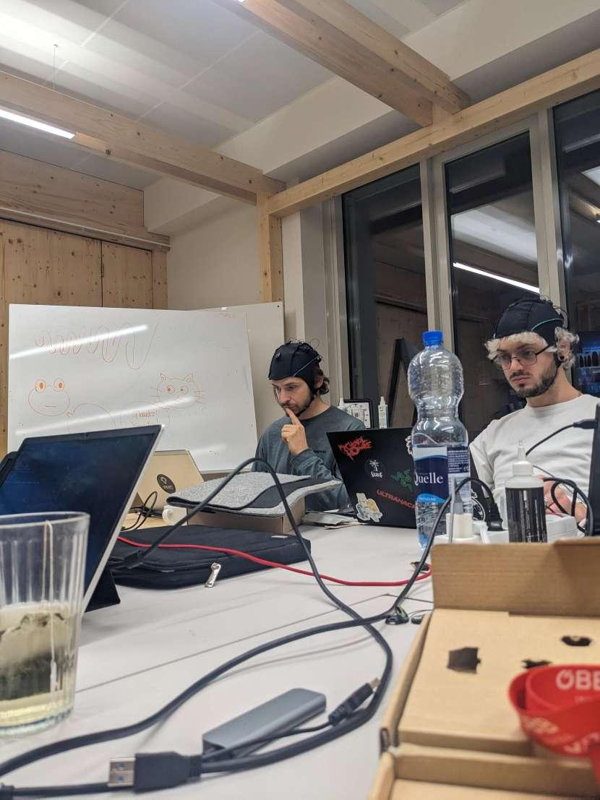
The Solution:
BCI Controller Overlay
Device: Unicorn
Calibration: 30 seconds
Selection: up to 30 classes
VEPs

Slide 4
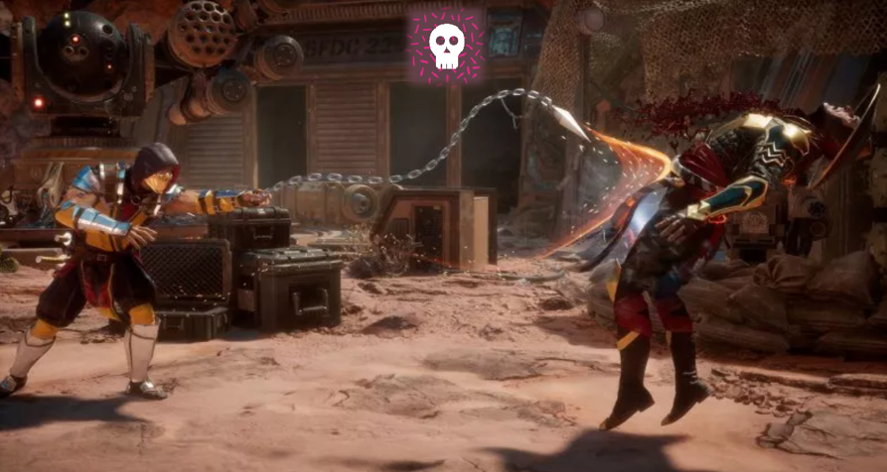
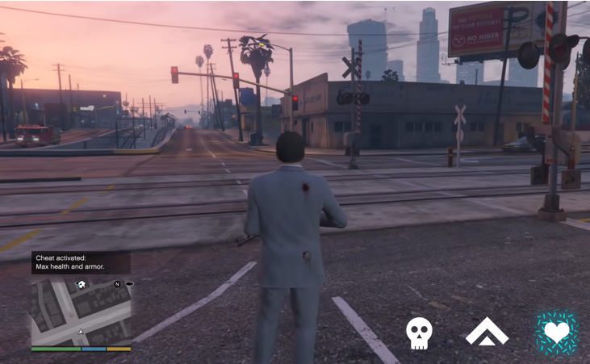
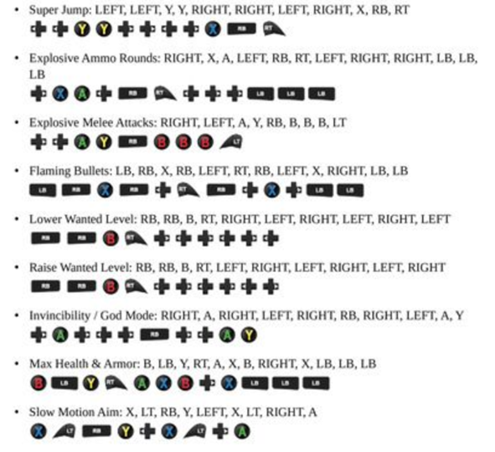
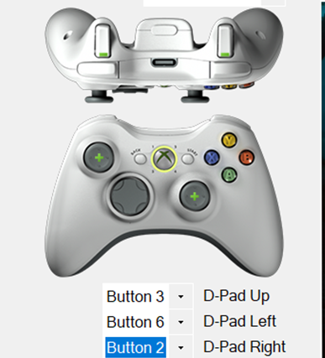
SPECIAL COMBOS

Slide 5
Video

Slide 6
Documentation
Youtube
github

